Slide 1
Bringing LSST Data to the Classroom Ardis Herrold Education Specialist, LSST Education & Public Outreach December 5, 2019

Slide 2
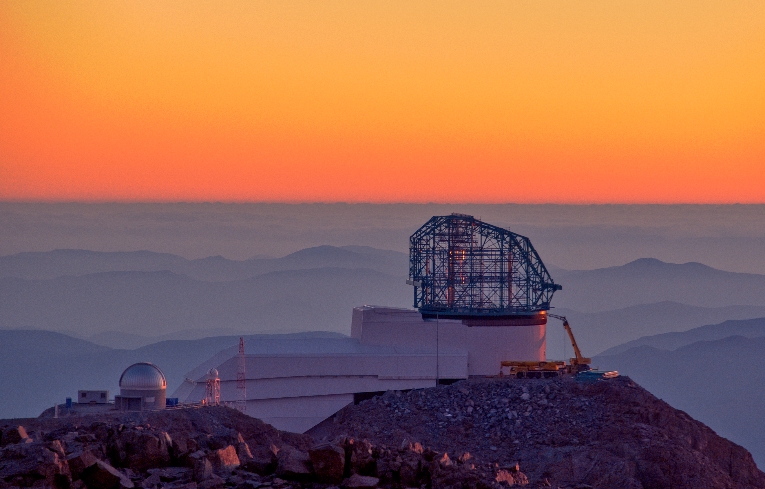
Goals of the LSST Education Team
24 pt Bold in
either blue or black
Bring LSST data into the classroom
Design appealing and engaging investigations
Incorporate topics and practices from the national standards
Support learners with diverse backgrounds and abilities
Design for the reality of the classroom (time, resources, curriculum)
Create support materials and professional development training
Guidelines
Delete notes and save this template as your presentation
No drop shadows
Only use the font Calibri or Carlito
Please do not alter template
Photo: LSST Project/NSF/AURA

Slide 3
Formal Education Audience
Primary outreach is to the United States and Chile.
Educators at the advanced middle school through college levels.
Decisions made:
Design for the many instead of the few
Student skill levels must be appropriate for strengths of LSST data
LSST is committed to working with partners, programs and institutions to develop materials that are relevant, accessible and engaging to diverse audiences, especially to those who are traditionally underrepresented in STEM.
Photo: Bob Blum/NSF/AURA

Slide 4
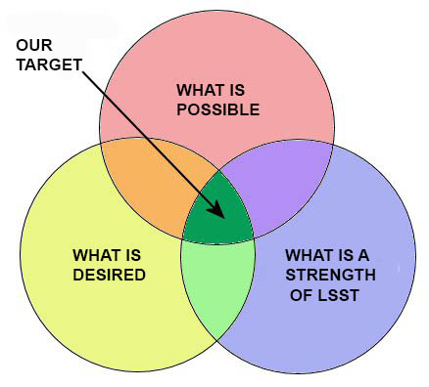
Investigation Design

Slide 5
24 pt Bold in
either blue or black
Guidelines
Delete notes and save this template as your presentation
No drop shadows
Only use the font Calibri or Carlito
Please do not alter template
Message box example for short highlighted messages.

Slide 6
Investigation | Description
Coloring the Universe | Students construct a color image from LSST’s filters and gain intuition for wavelength-dependent properties of a variety of astronomical objects.
A Window to the Stars | Students compare properties of the Sun and other stars using H-R Diagrams of star clusters.
Mapping the Milky Way | Students explore density maps to determine what type of galaxy the Milky Way is, and where we are located within it.
Expanding Universe | Students construct Hubble plots to evaluate the expansion and acceleration of the Universe over time.
Exploding Stars | Students interpret light curves to determine the type of supernova, the progenitor star, and to calculate the distance to galaxies.
Surveying the Solar System | Students make observations of newly-discovered solar system objects using an orbit visualizer to determine the object type.
Unlocking Distances Beyond the Milky Way | Students analyze Cepheid variable light curves to calculate distances to galaxies.
Hazardous Asteroids | Students evaluate the potential threat of an Earth impact by making repeated observations of a newly-discovered Near-Earth Object.
Exploring the Observable Universe | Students explore large-scale structure using photometric redshifts and galaxy density maps.

Slide 7
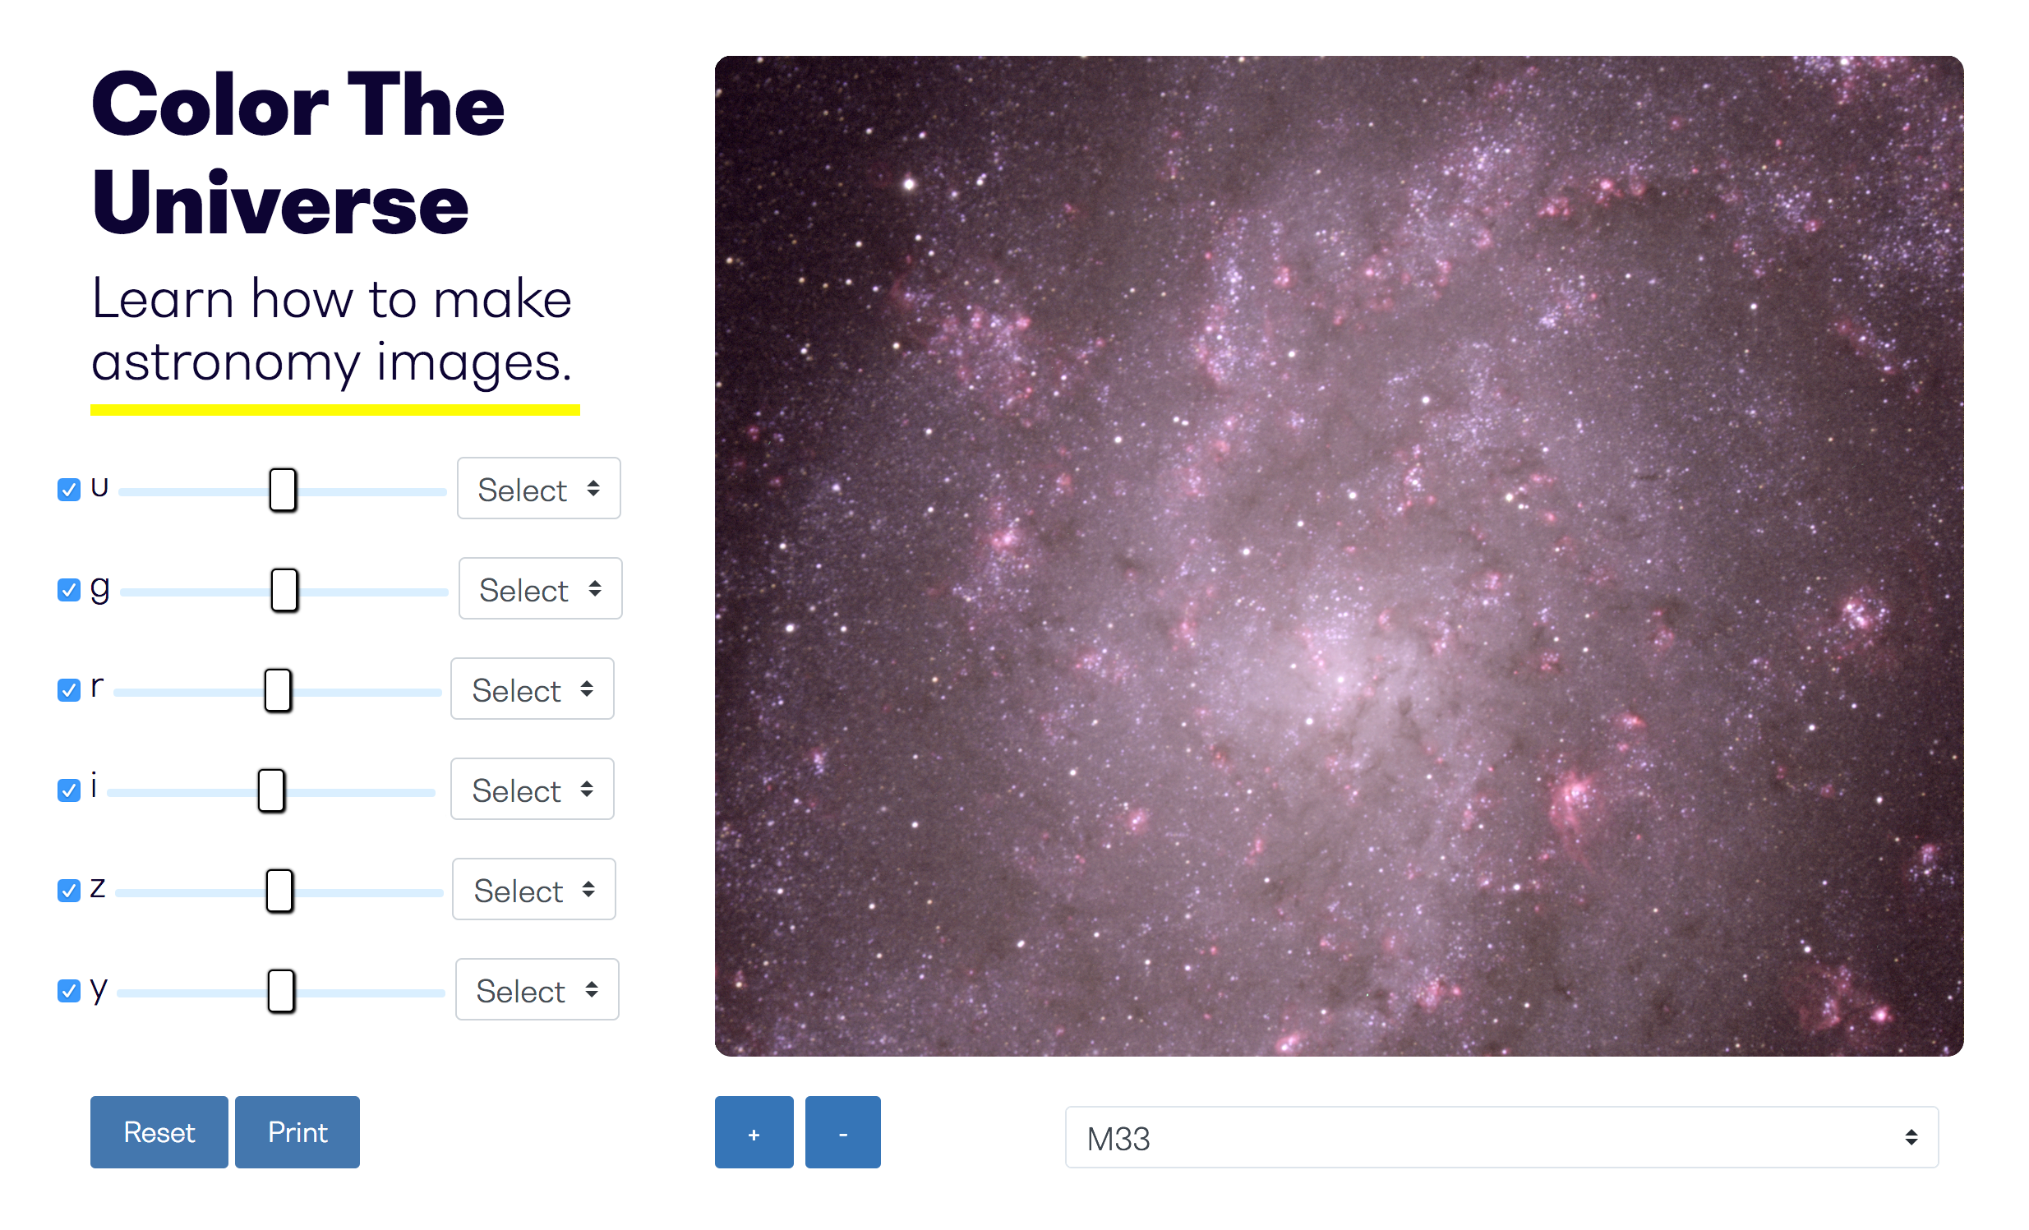
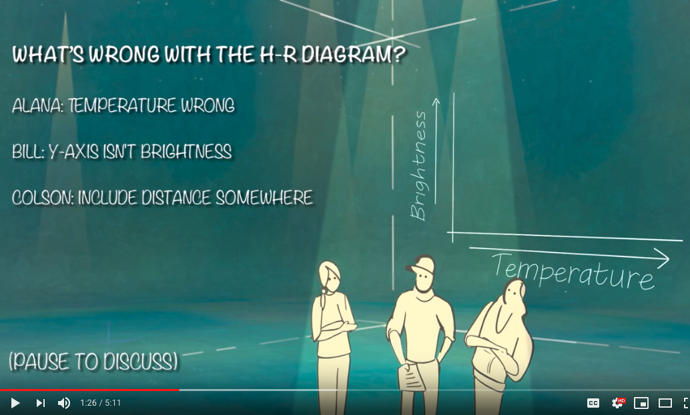
Investigation Components
Web application
Teacher guide
Investigation videos*
Assessment materials
Website support materials
*for a subset of investigations
Message box example for short highlighted messages.

Slide 8
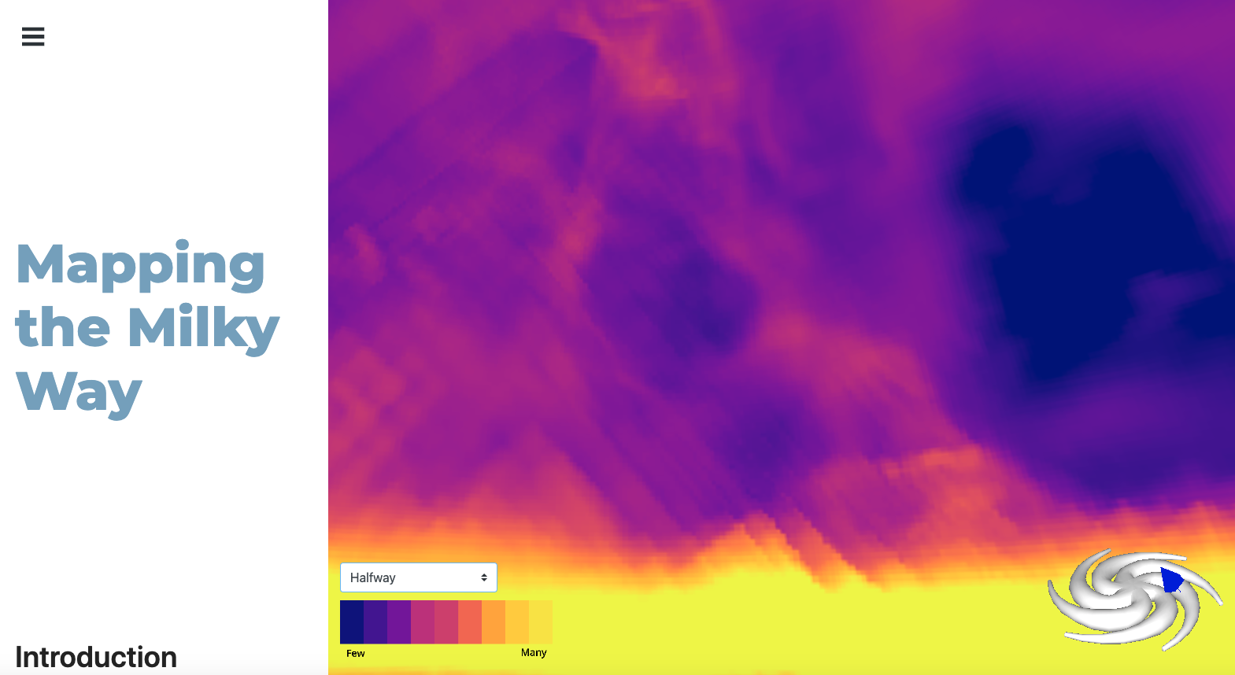
Web Applications
Accessible through a website
Embedded tools for data interaction & analysis
No downloads
Message box example for short highlighted messages.

Slide 9
Investigation Design
Message box example for short highlighted messages.

Slide 10
Investigation Design

Slide 11
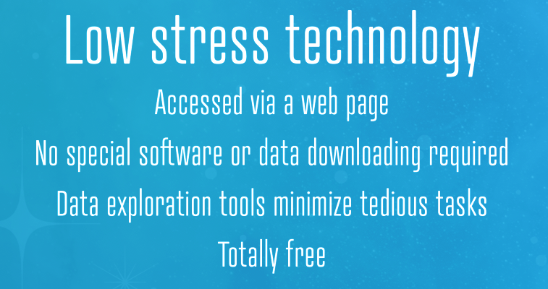
Investigation Design

Slide 12
Guiding Principles of Investigation Design
Sample excerpts:
Students should interact with LSST data (making procedural decisions, analyzing data, etc.)
Investigations must rely on the unique qualities of LSST data (its depth, volume, time domain aspect).
Each investigation should be able to be completed in two hours.
Investigations should include representations, questions and tasks that address student comprehension and reasoning difficulties.
Each investigation should be designed with a progression of concepts and tasks that are necessary for students to make sense of the big ideas of the investigation.

Slide 13
Links to investigation prototypes
A Window to the Stars http://ls.st/0ed
Exploding Stars http://ls.st/5ym
Teacher guide phase 1:
Mapping the Milky Way http://ls.st/62n
Sample Assessment video
(H-R Diagram English) http://ls.st/k1o
(H-R Diagram Spanish) http://ls.st/bam

Slide 14
Designing for Diversity and Inclusion
Investigations avoid use of examples and language that are specific to a certain culture, socioeconomic class, or region.
Students are asked to relate new ideas to their common experience.
Where possible, students are given some latitude in how they choose to express or represent their learning.
***The above strategies are promoted by The ACESSE Project (Advancing Coherent and Equitable Systems of Science Education)***
Multiple supports are provided within each investigation to meet the appropriate challenge level and needs of all learners.
Websites and online interactives will meet or exceed Level A requirements
of the Web Content Accessibility Guidelines through the World Wide Web Consortium process.

Slide 15
Marketing
What infrastructures exist within school districts, educator organizations, the Ministry of Education?
Where does (or how can) the teaching of astronomy fit in the high school physics curriculum?
How do people know about your outreach services?
What social media (and other media) are popular and effective?
What informal education centers and networks exist and how do they disseminate information?
Does funding exist for professional development workshops?
Who can you partner with?

Slide 16
Construction Timeline
for Formal Education
Complete writing first drafts of investigations
Begin coding and widget development
Begin development of support materials and website
Coding and widget development
User testing
Investigation iterations
2019
User testing
Investigation iterations
Begin pilot testing
2020
2021
Pilot testing
Investigation iterations
Begin professional development
.
Professional development
Launch of first investigations for use
2023
2022

Slide 17
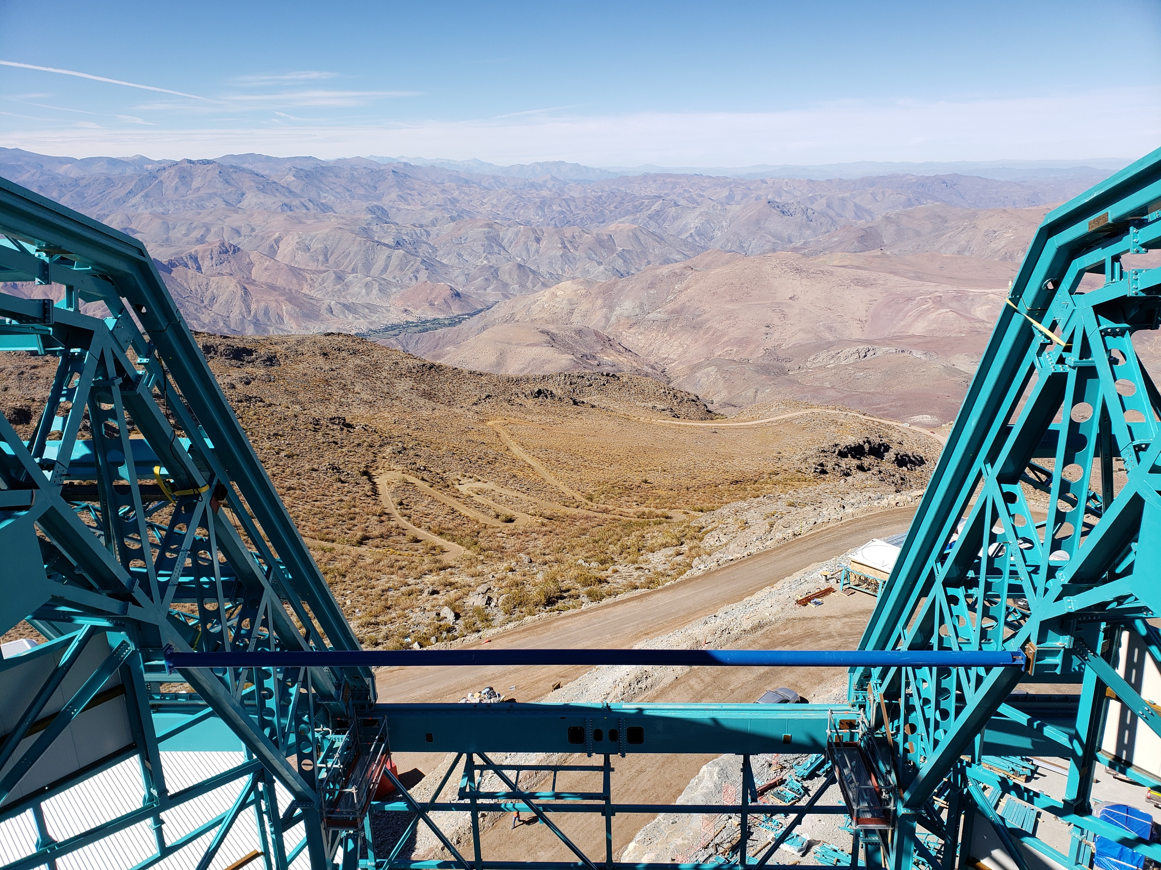
As we continue construction, please contact us with your ideas and questions:
education@lsst.org
Thank you!
Message box example for short highlighted messages.
Photo: LSST/NSF/AURA

