Slide 1
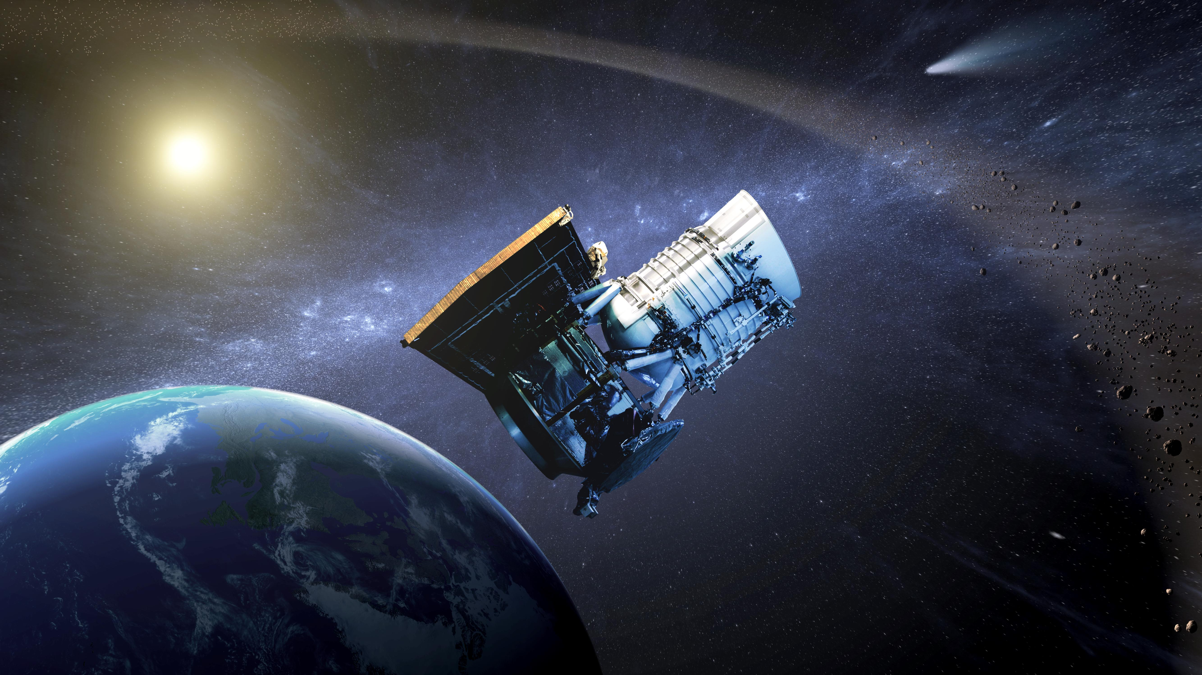
NEOWISE tools and techniques
Joseph Masiero
(NASA Jet Propulsion Laboratory /California Institute of Technology)
5 Mar 2020
© 2020 California Institute of Technology. Government sponsorship acknowledged.

Slide 2
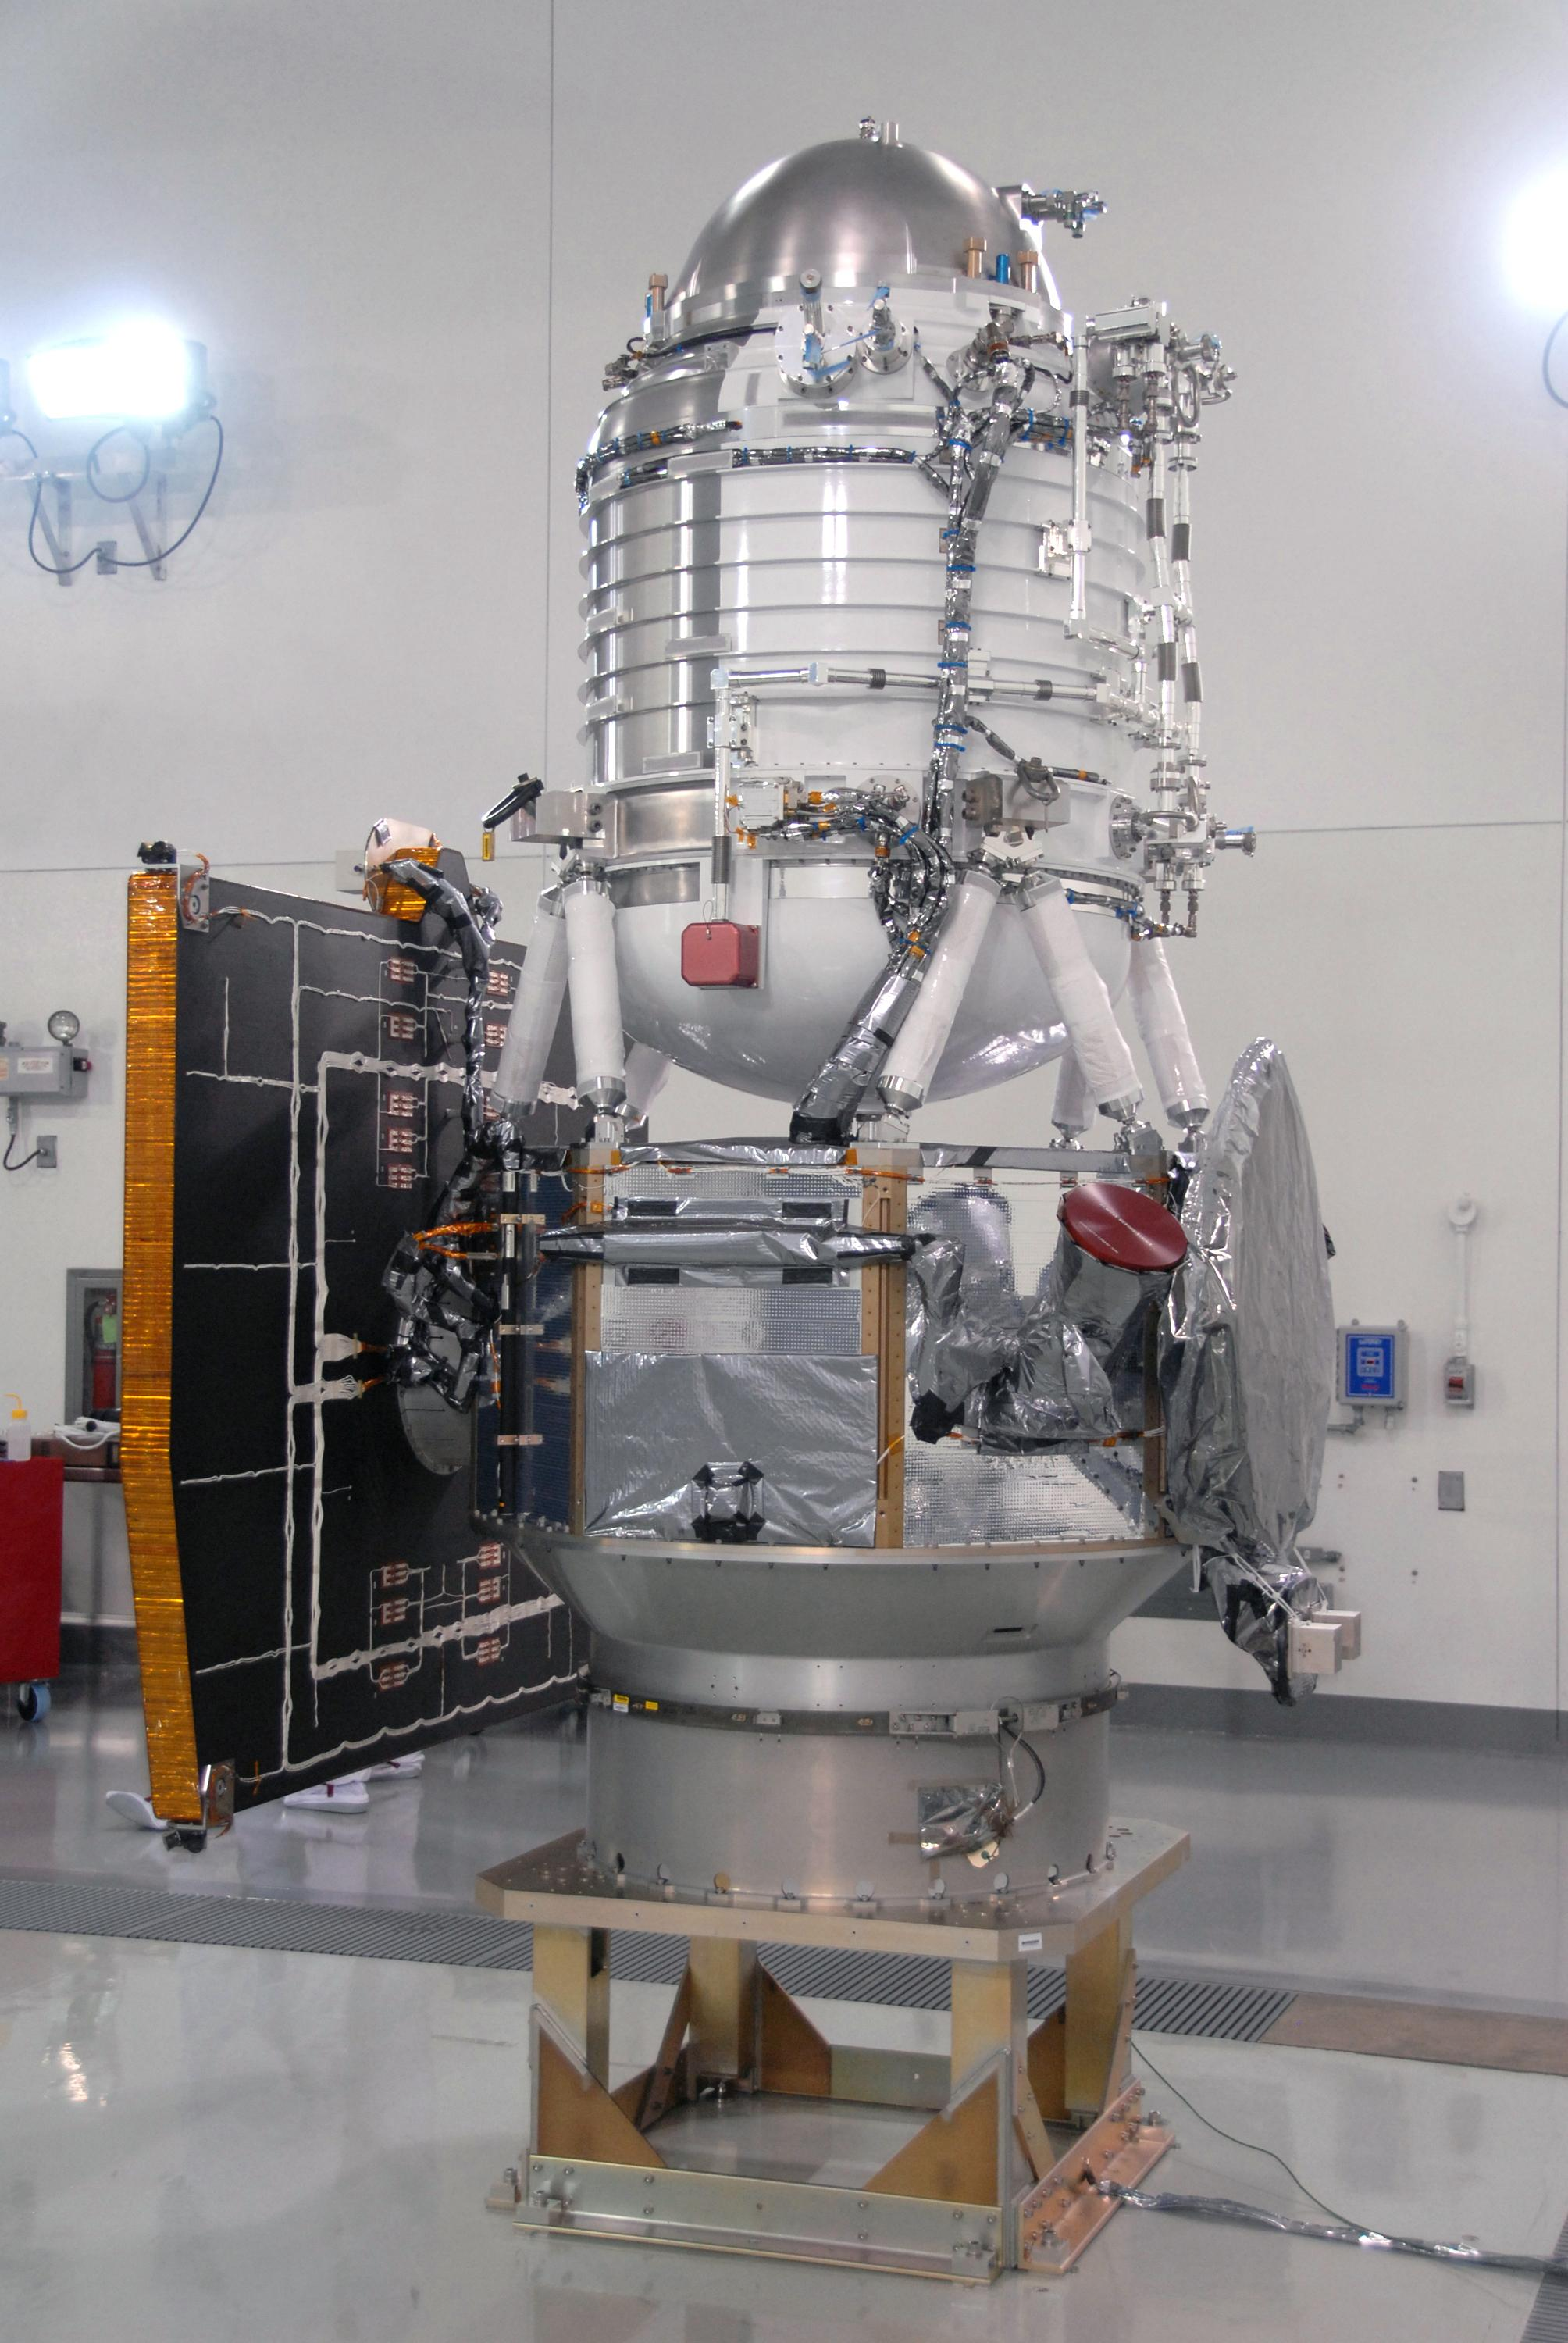
NEOWISE: Origin Story
PI-led (PI: Amy Mainzer, U. Arizona) mission under NEOO Program (Lindley Johnson, Program Exec)
Utilizes WISE spacecraft that was brought out of hibernation in October 2013
3.4 and 4.6 µm bands (W1 and W2) at 75K
Continues original WISE orbit and survey plan
Science operations: >6 years starting 12/2013
NASA JPL
Science Goals:
Survey of NEOs at mid-infrared wavelengths
Discovery of new NEOs
Physical property characterizaion

Slide 3
The WISE mission
NASA Mid-class Explorer mission
6 month survey of the entire sky at 4 simultaneous infrared wavelengths
3.4, 4.6, 12, 22 microns
40 cm mirror
Cryogenically cooled with solid hydrogen
Launched Dec 14, 2009 onto a polar, sun-synchronous orbit
Surveyed from Jan 14, 2010 to Sept 30 2010
8 detections at ecliptic, rising to hundreds at the poles
PI: Ned Wright (UCLA)
NASA JPL

Slide 4
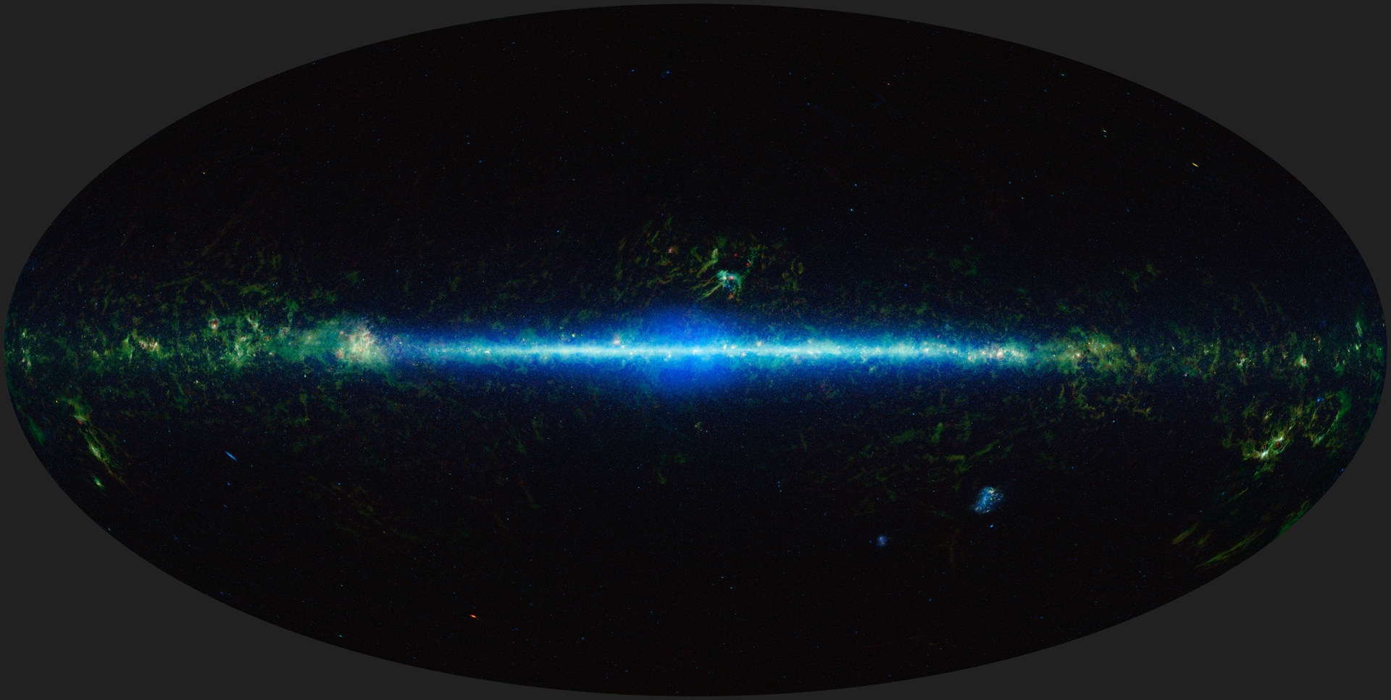
WISE science goals
NASA JPL/IPAC
Most luminous galaxies in the universe
Coldest, closest brown dwarfs
Infrared atlas for JWST, etc

Slide 5
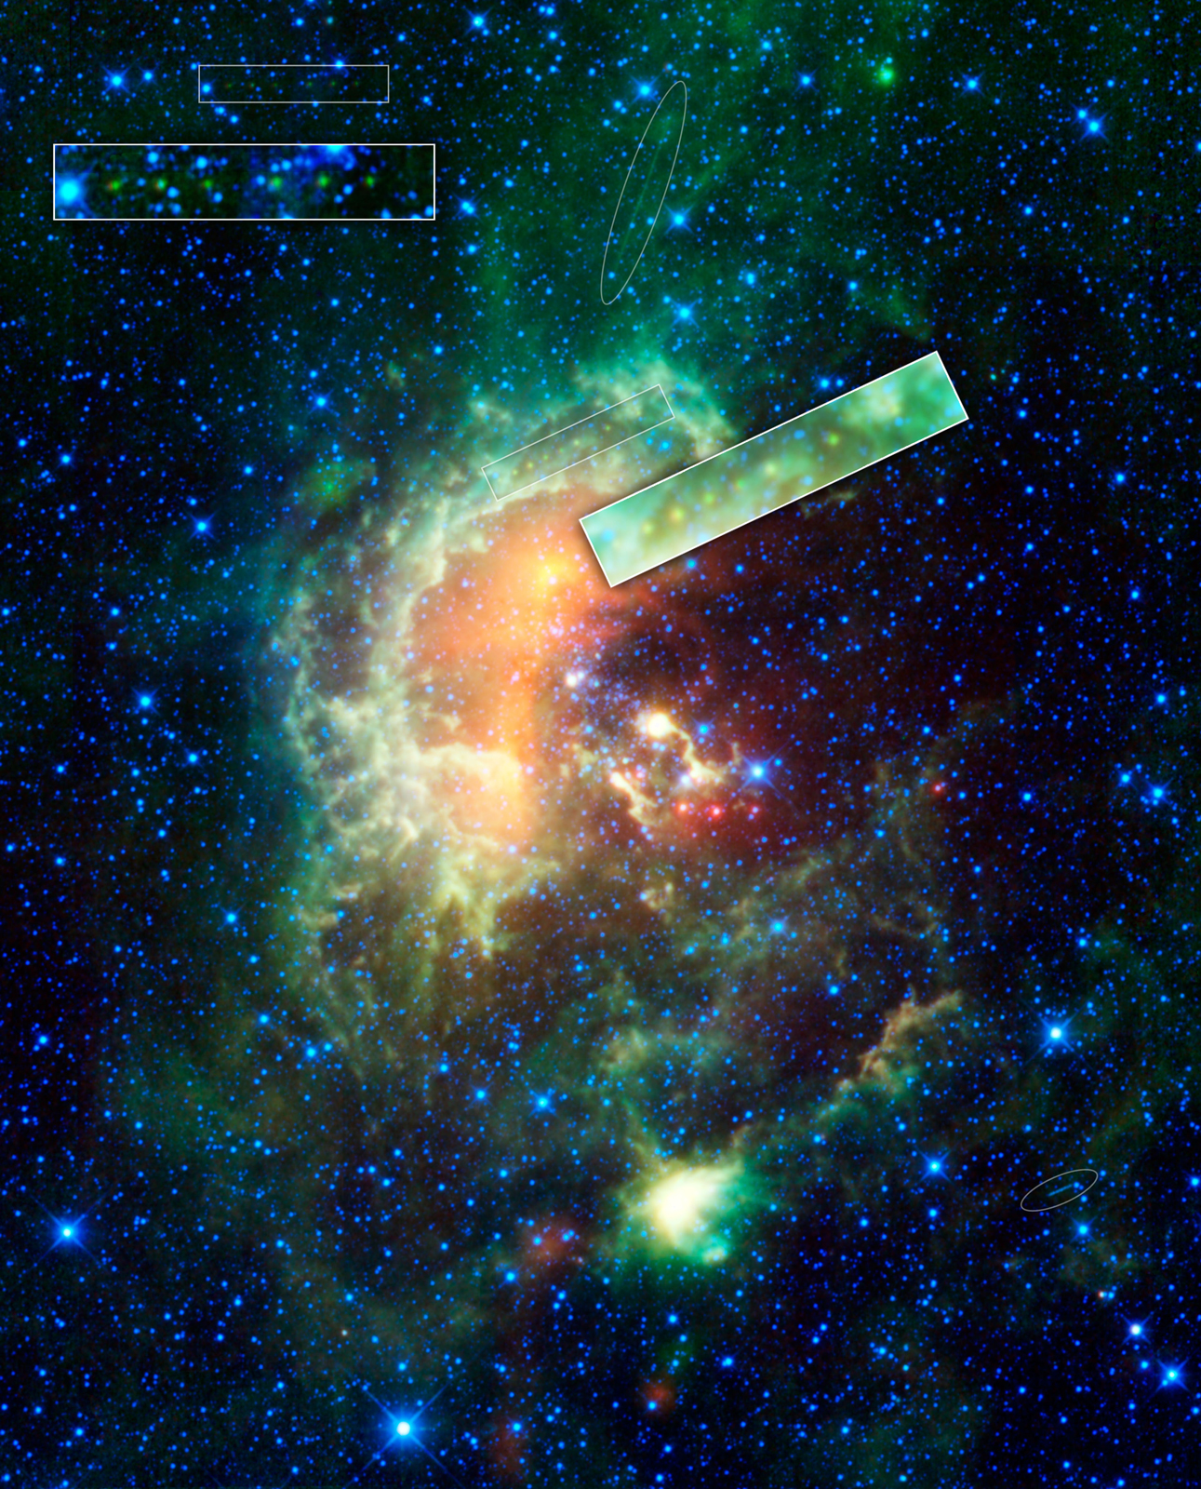
WISE single frame data
Original mission plan did not include archiving single frame data
However, asteroids are some of the brightest objects in mid-infrared sky
Solar system objects and stationary transients would have been lost
NASA JPL/IPAC

Slide 6
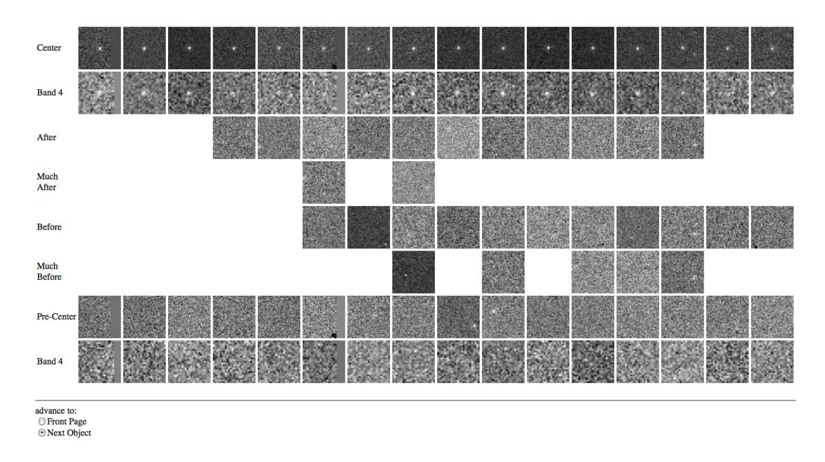
WISE Moving Object Processing System
Automated object detection and linking, combined with human QA

Slide 7
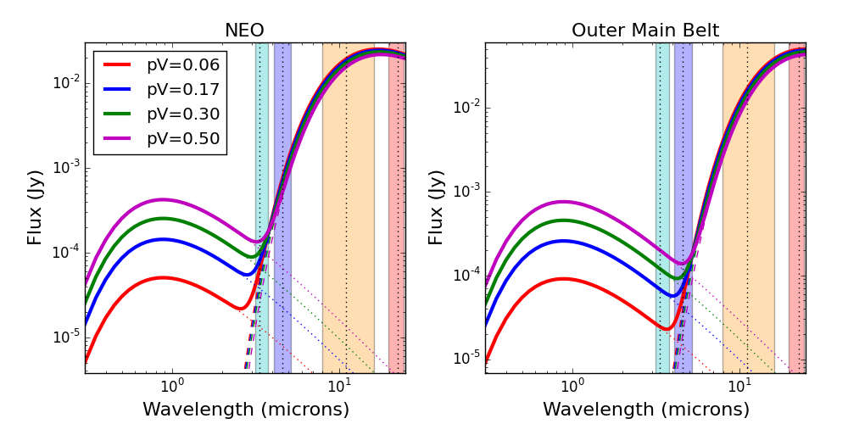
Determining asteroid diameters
Diameters constrained with thermal models
Literature optical data allow for albedo determination

Slide 8
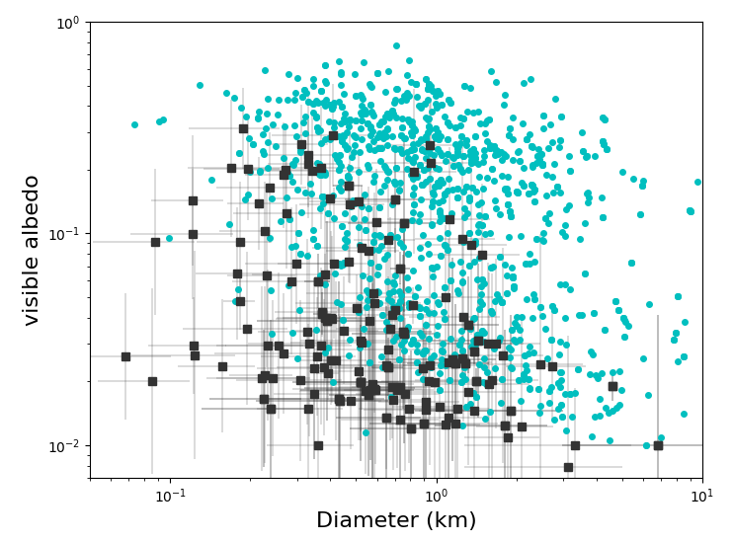
NEOWISE detections
Masiero et al. 2020
NEOWISE-Reactivation observations of known NEOs (cyan) and new NEO discoveries (black) in years 1-5

Slide 9
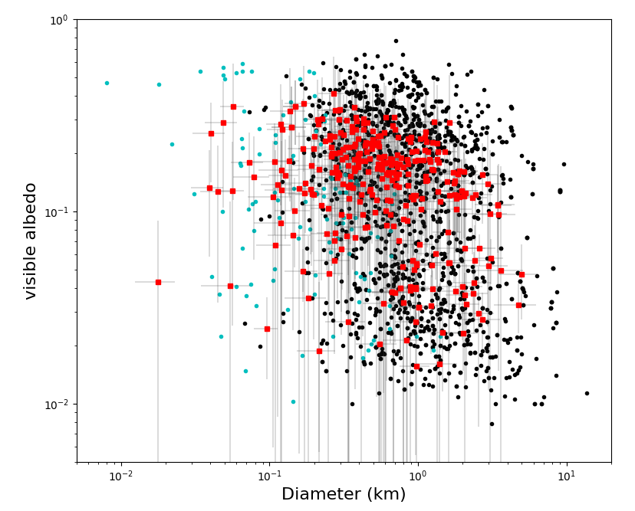
NEOWISE non-detections
Masiero et al. submitted
NEOWISE-Reactivation automatically detected NEOs (black) vs. manual recoveries from recent work (red) and previous work (cyan)

Slide 10
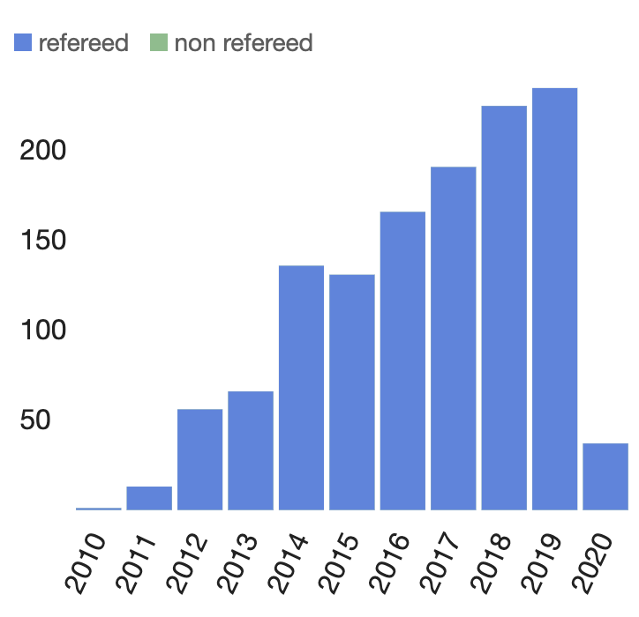
NEOWISE Science Results
To date over 1,200 publications have made use of NEOWISE single-frame data or NEOWISE-derived physical properties
Over 3,500 publications have made use of data from all phases of the WISE mission.
Graph from ADS

Slide 11
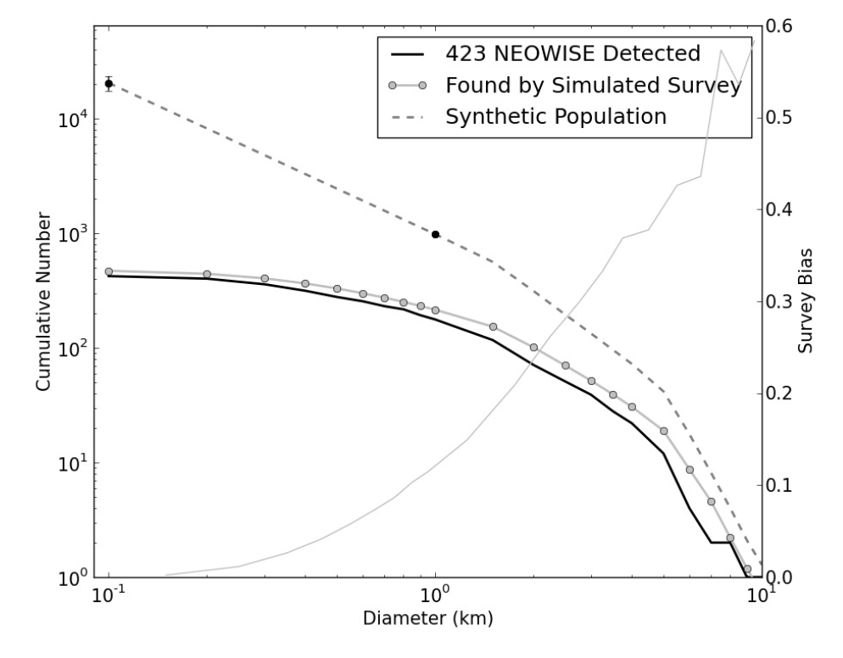
The number of NEOs
NEOWISE survey debiasing found 981±19 NEOs > 1 km
>90% currently known
Mainzer et al. 2011e

Slide 12
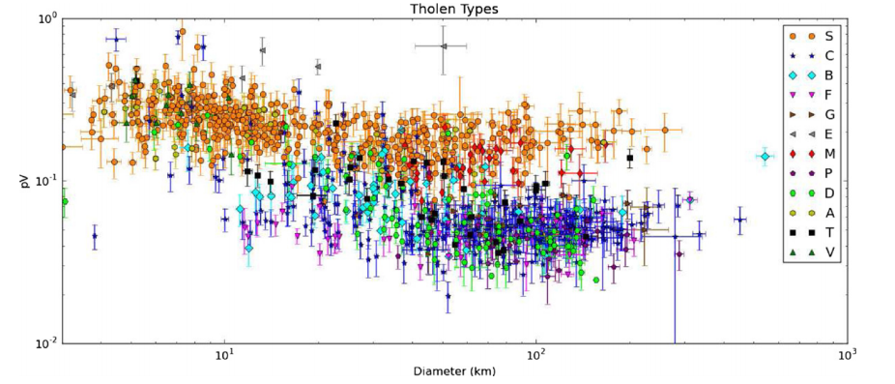
Taxonomy-albedo connection
Mainzer et al. 2011d
Albedo and taxonomy correlated, though with some spread

Slide 13
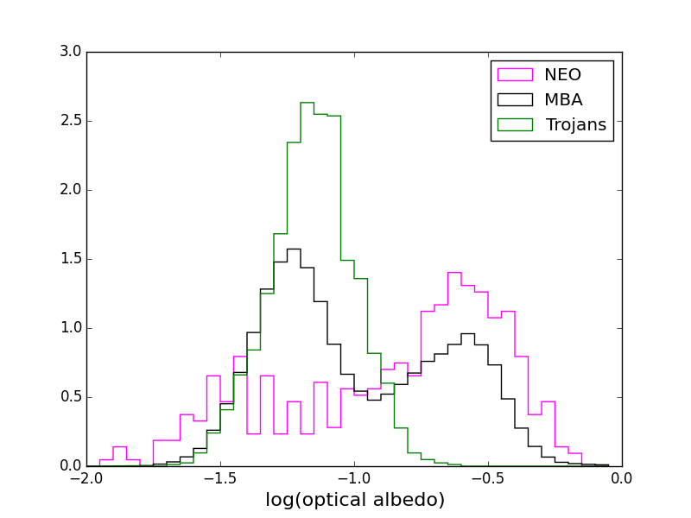
Asteroid albedos across the Solar system
Data from PDS
Objects become darker farther from the Sun

Slide 14
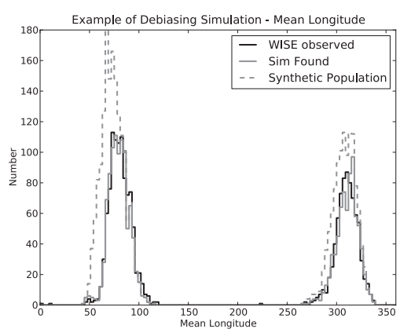
Jupiter Trojan population
Grav et al. 2011
Number of Trojans is different between the leading and trailing cloud

Slide 15
3.4 micron albedos
Masiero et al. 2014
Fits of albedo at the shortest wavelengths indicates 3 distinct populations in the Main Belt

Slide 16
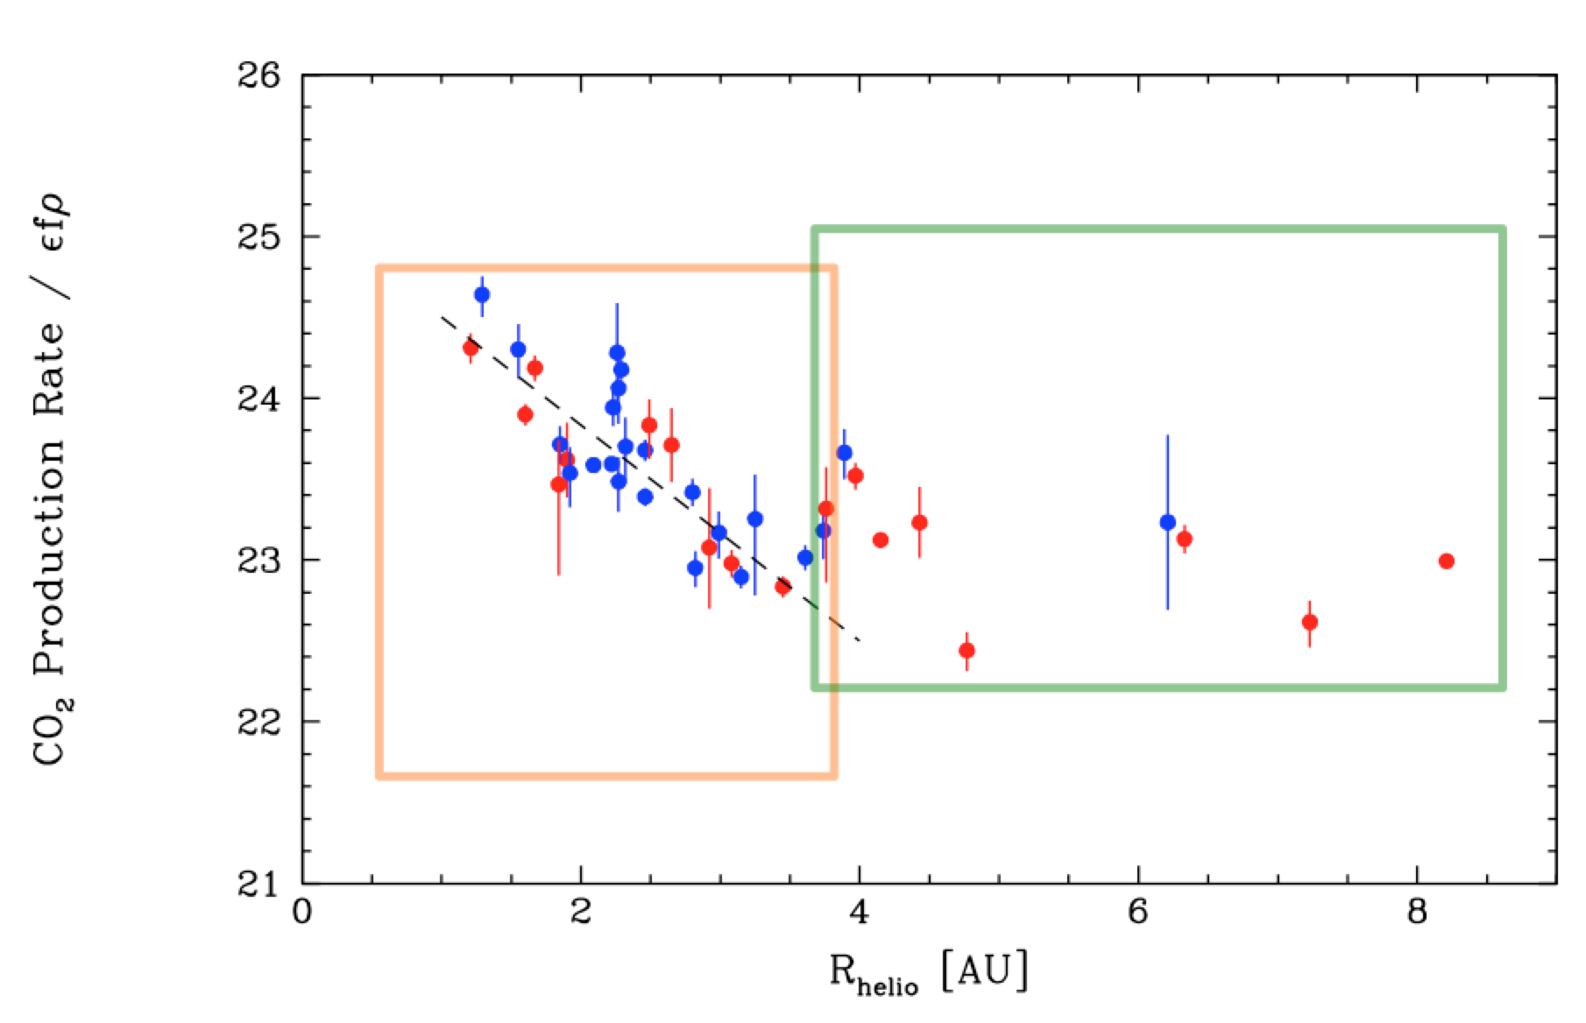
Cometary CO/CO₂
Bauer et al. 2015
No difference in gas/dust production ratio between long-period (red) and short-period (blue) comets

Slide 17
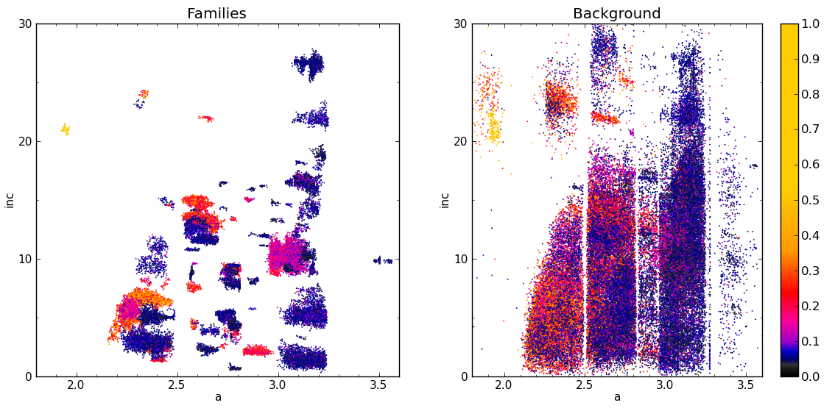
Asteroid Families
Inclination (deg)
Inclination (deg)
Semimajor axis (AU)
Semimajor axis (AU)
Masiero et al. 2013
Known families represent > 1/3 of all asteroids

Slide 18
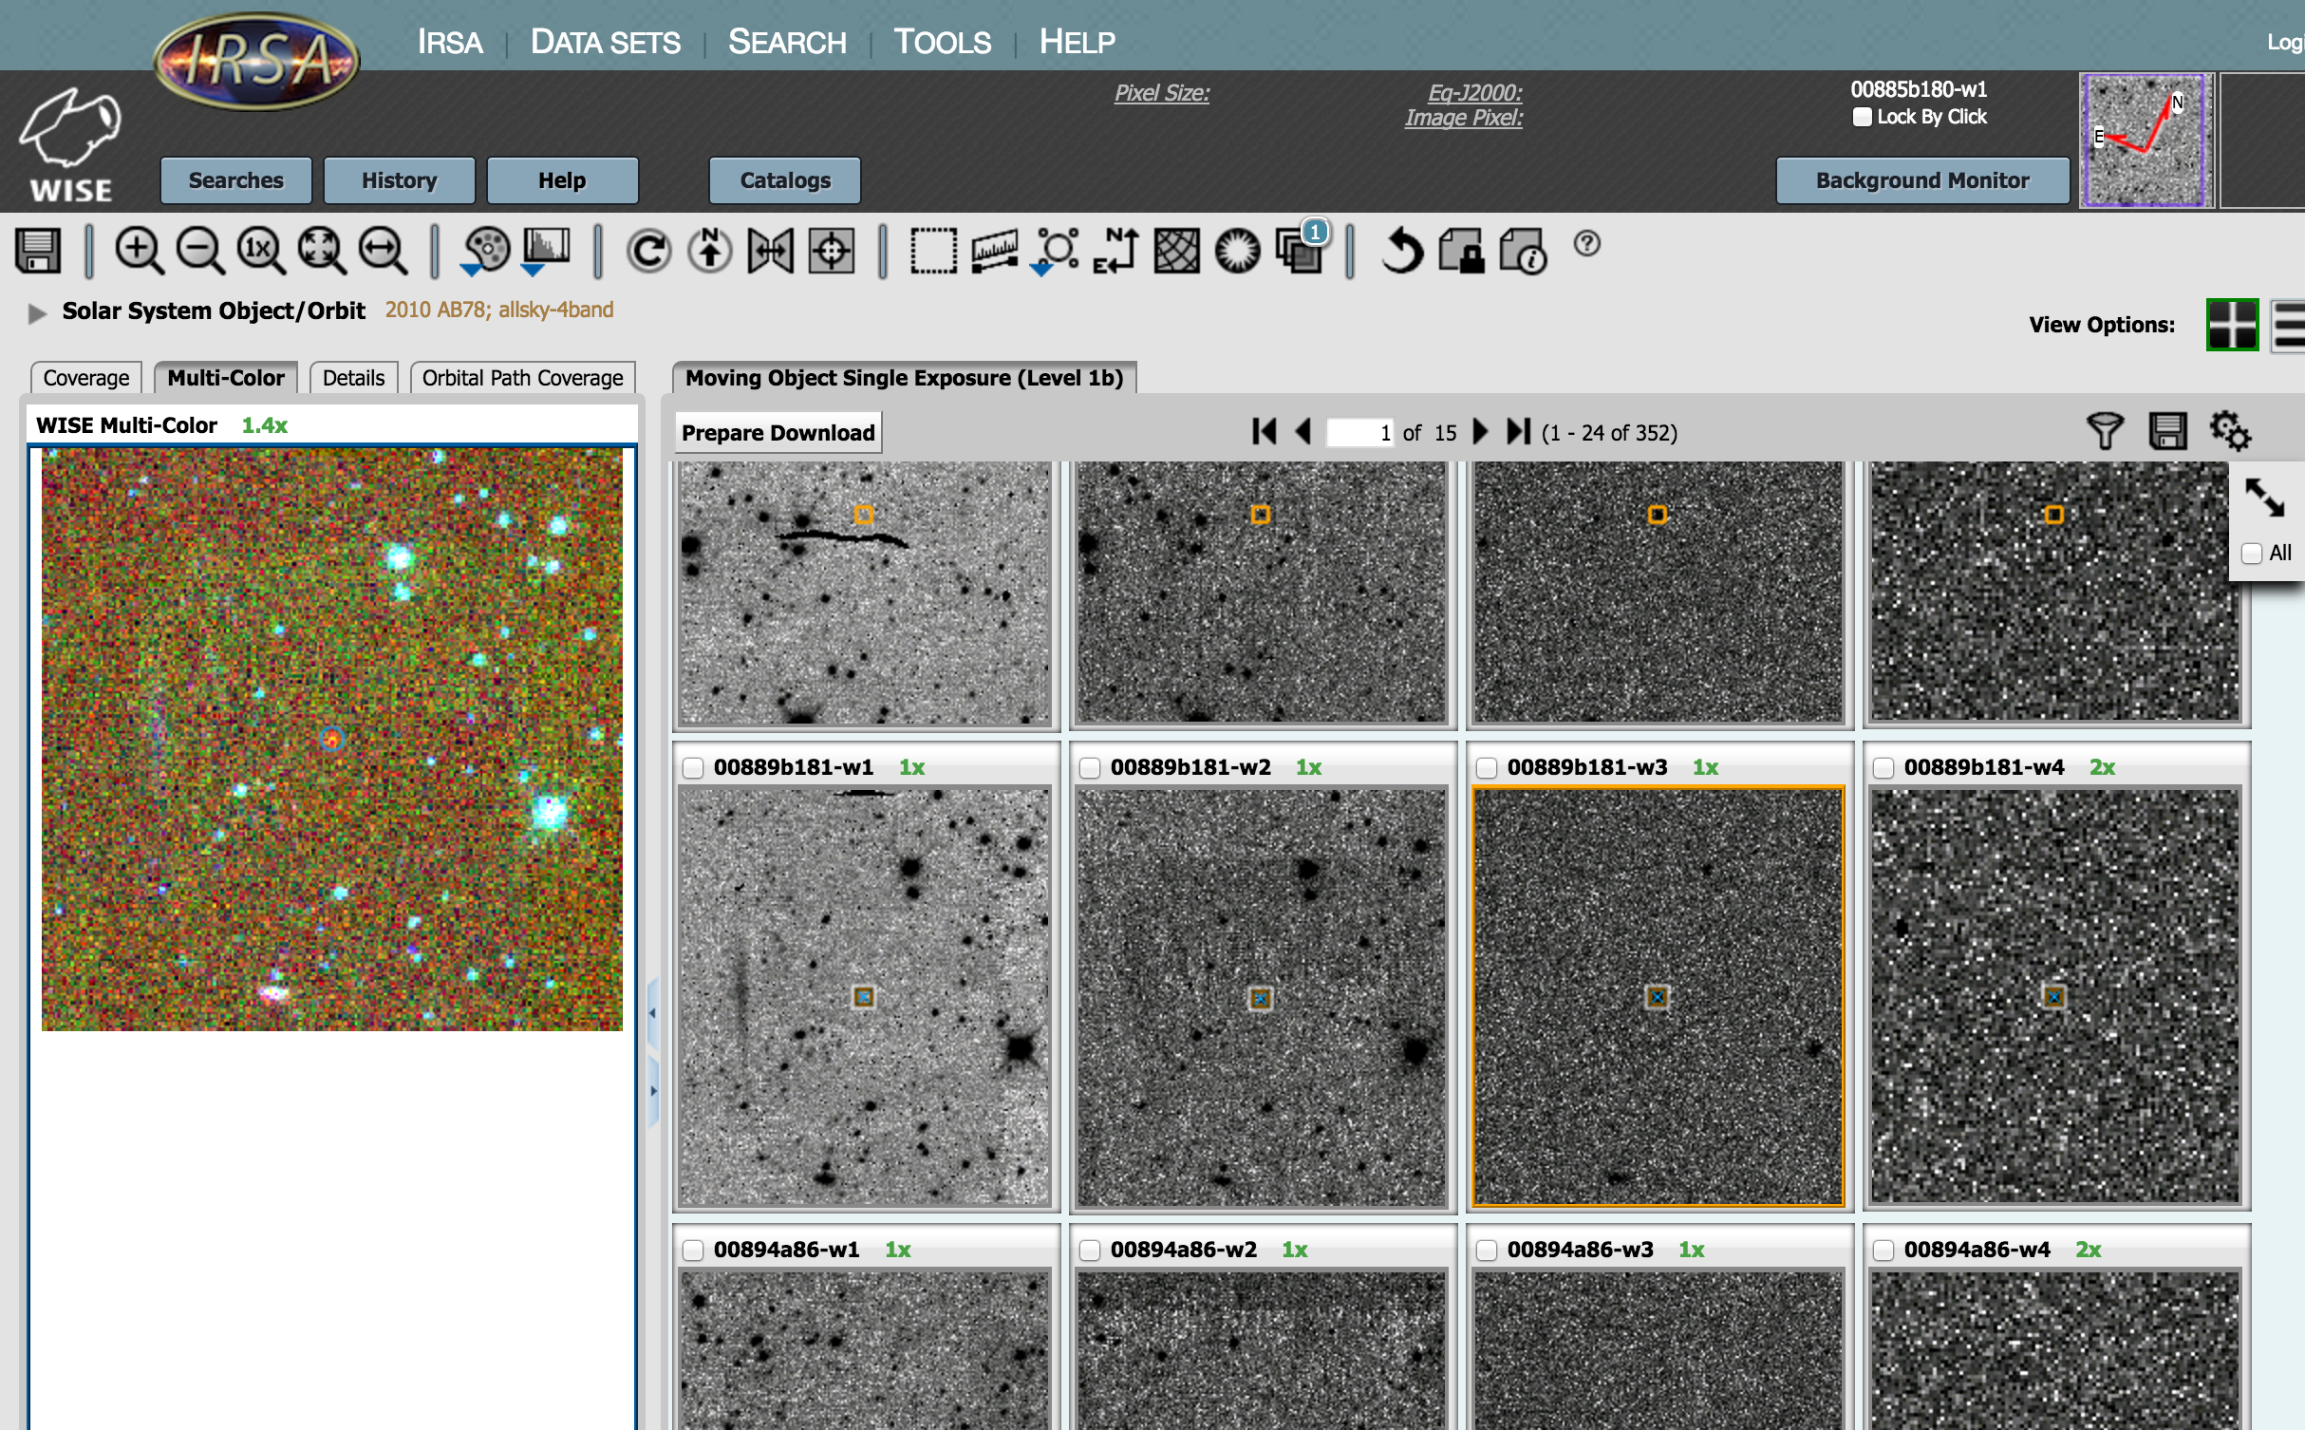
How to get the data: IRSA
Source catalogs, single frame images, and atlas images are hosted on the NASA/IPAC Infrared Science Archive
https://irsa.ipac.caltech.edu/Missions/wise.html

Slide 19
How to get the data: PDS
NASA Planetary Data System hosts the derived physical properties previously published
https://sbn.psi.edu/pds/resource/neowisediam.html

Slide 20
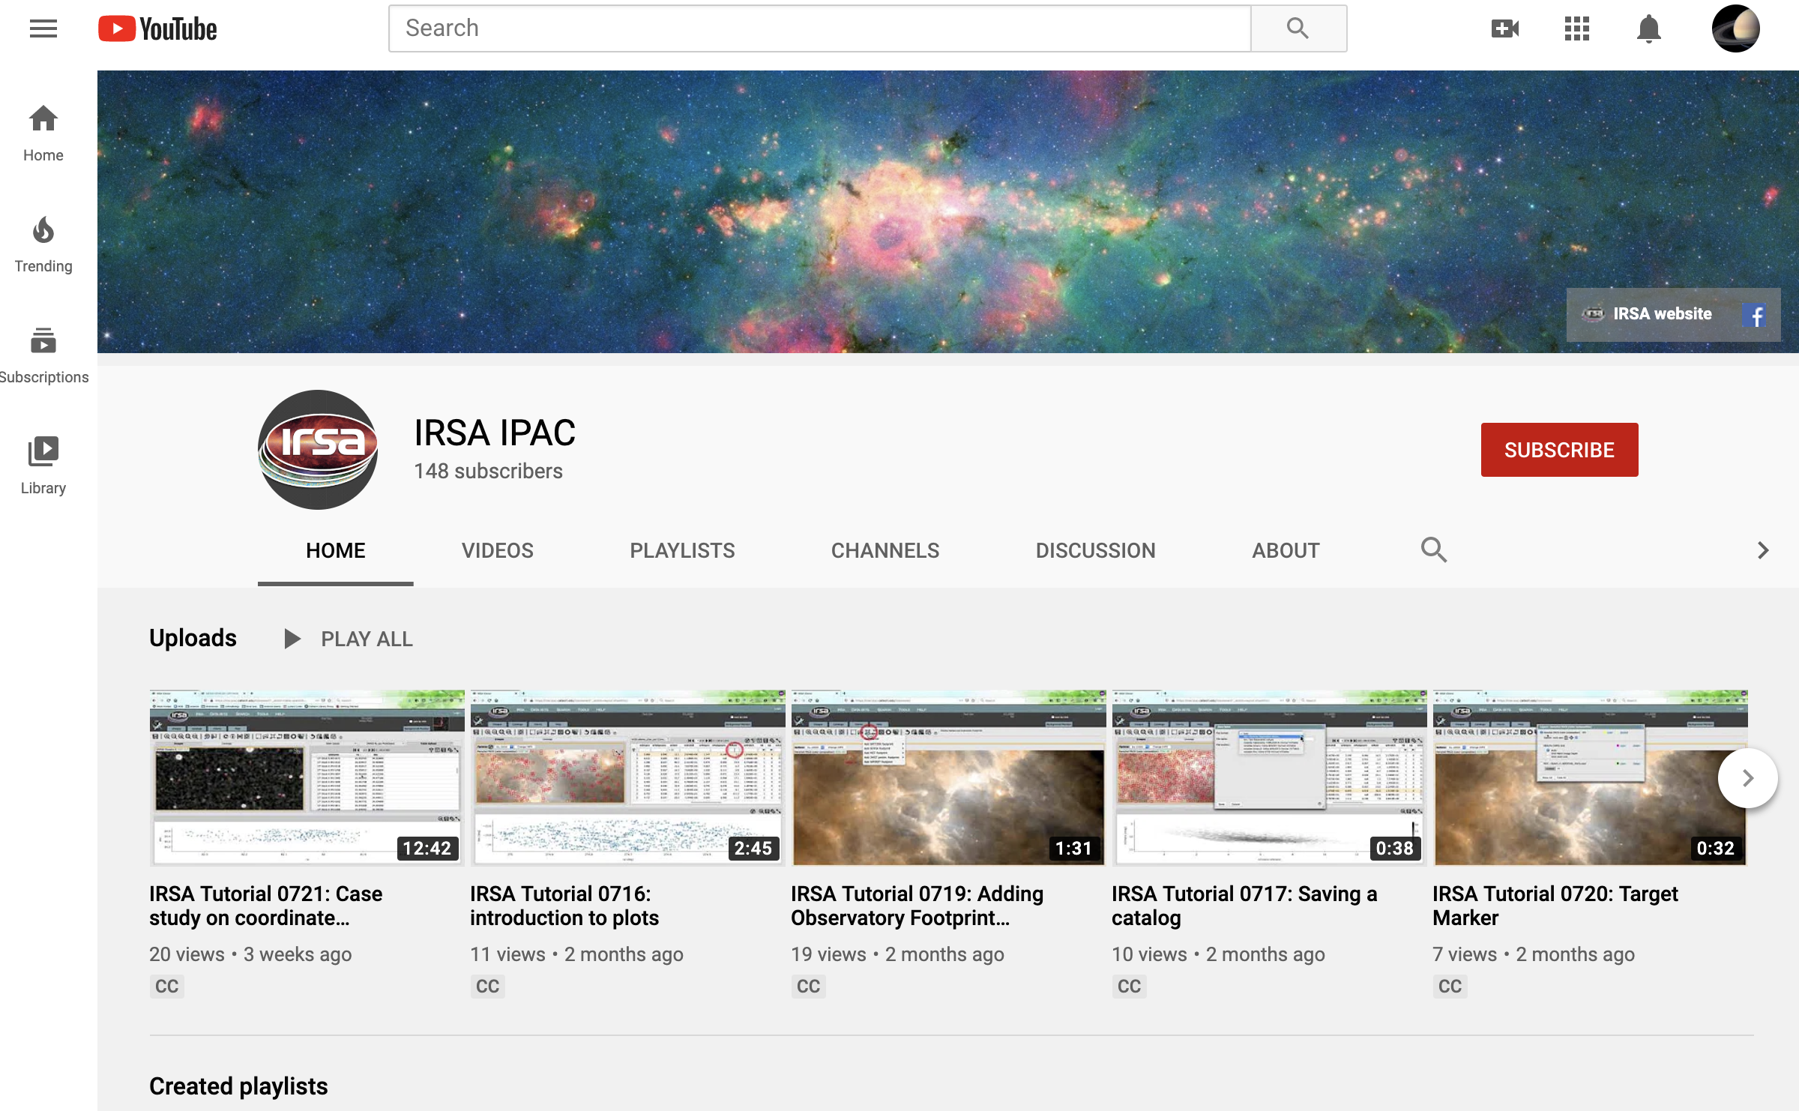
Demos here:
Youtube: IRSA IPAC channel
https://www.youtube.com/channel/UCIysJbamhNnlu0Bgdrwxn_w

